Slide 1
Thuyết trình nhập môn thị giác máy tính
Object Removal Using seam-carving
Danh sách nhóm:
Nguyễn Đỗ Quang – 20520720
Âu Thiên Phước - 19522050

Slide 2
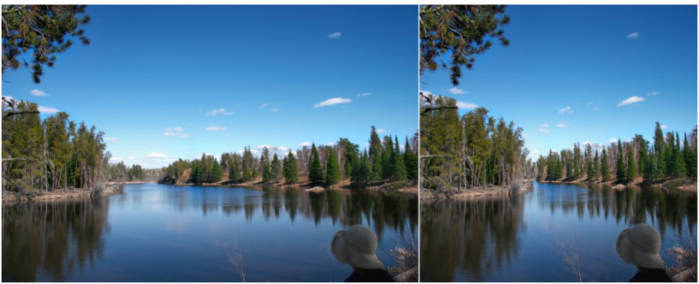
1.1 Seam-carving:
Seam carving is an algorithm for content-aware image resizing

Slide 3
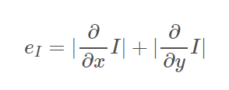
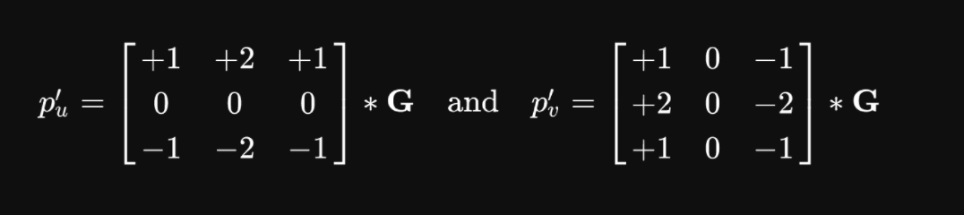
1.2 Gradient-magnitude
The energy function presented in the original seam carving paper is the simple gradient magnitude:
Convolution with kernel

Slide 4
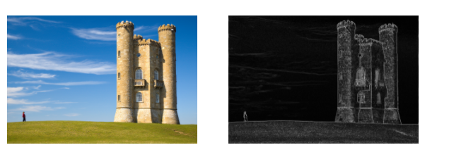
1.1 Gradiant-magnitude
Below we see an image and its “energy map”, which is the gradient magnitude - computed with a simple convolution operation.

Slide 5
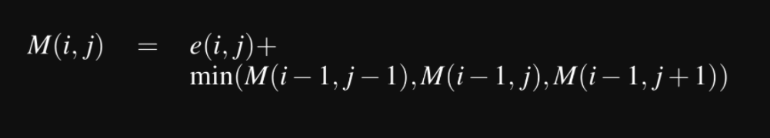
1.3 Dynamic programming

Slide 6
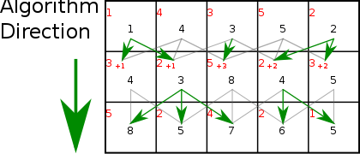
1.3 Algorithm Direction:

Slide 7


1.4 Image and mask

Slide 8

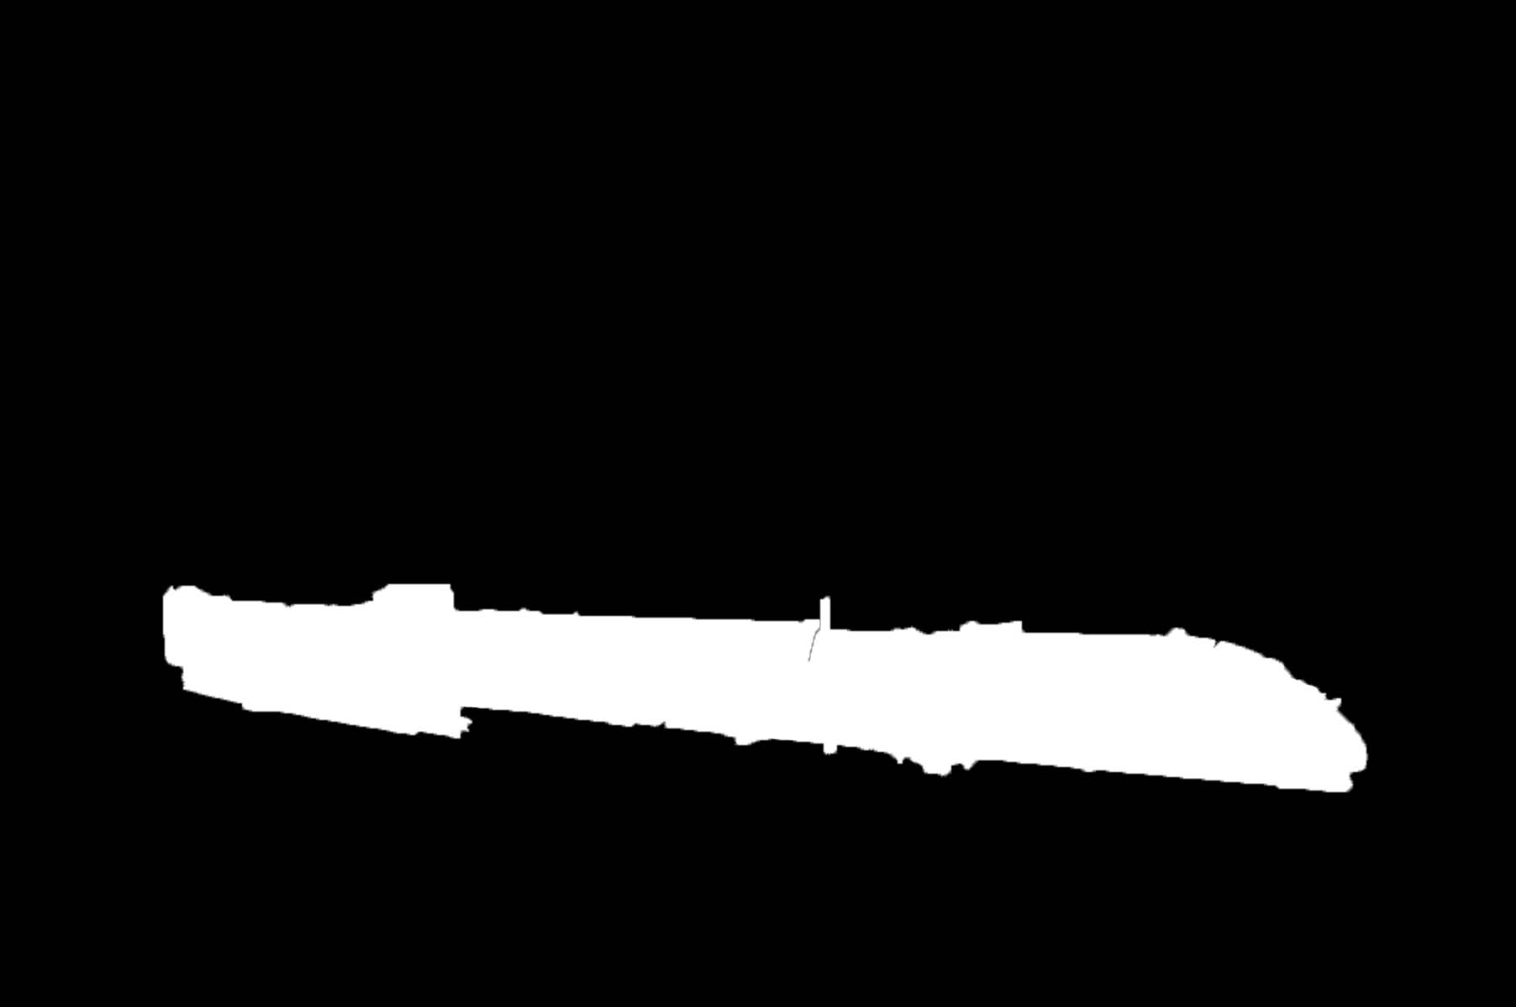
1.4 Image and mask

Slide 9

1.5 Successful case

Slide 10
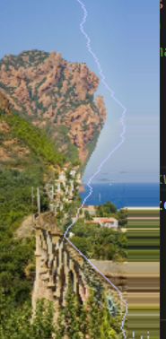
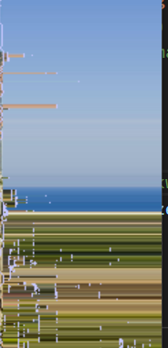
1.6 Failed Case

Slide 11

1.7 Improvement:

Slide 12
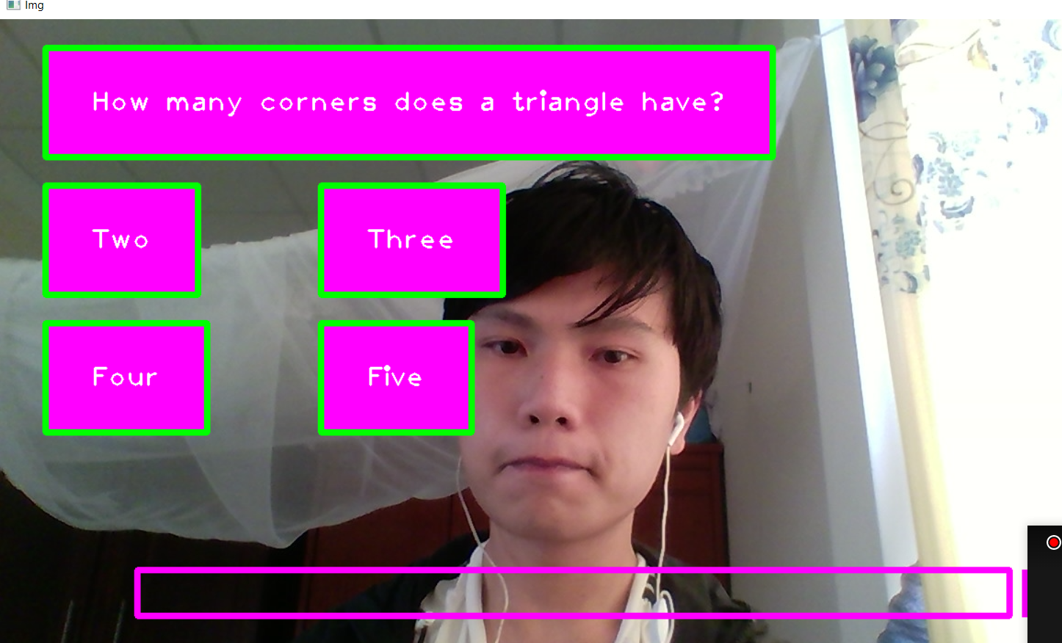
2.1 Quiz Game
Using cvzone library to detect hand gestures

Slide 13
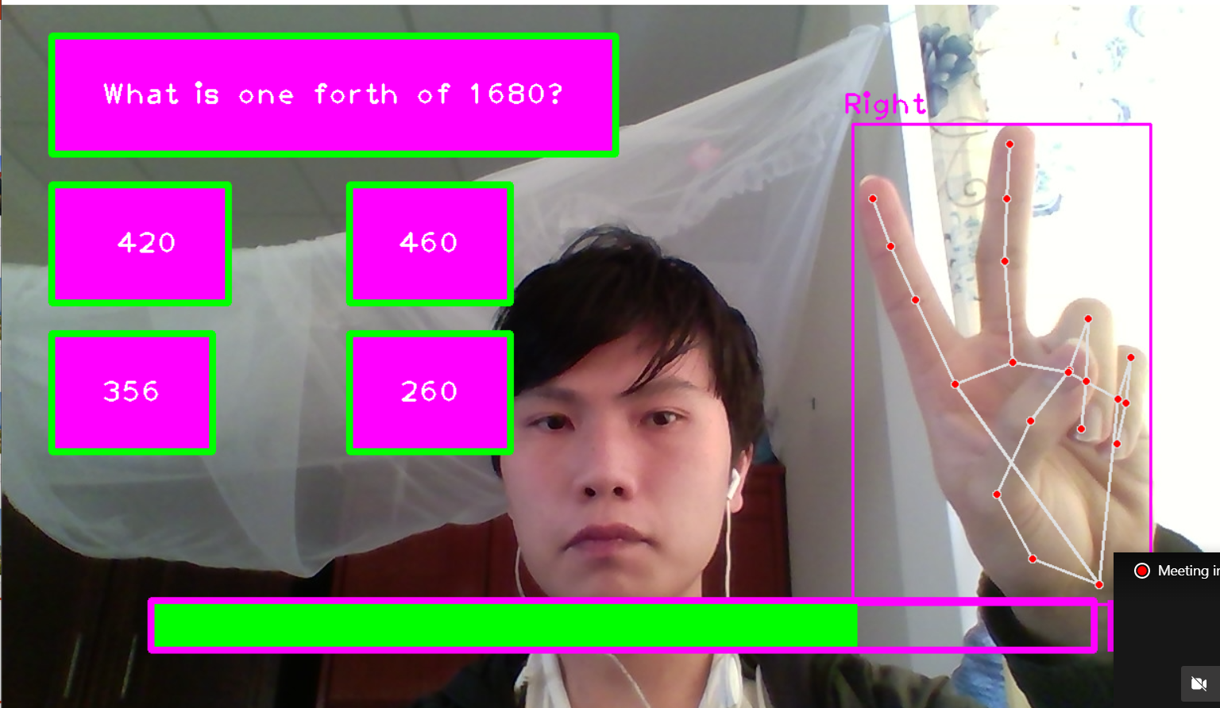
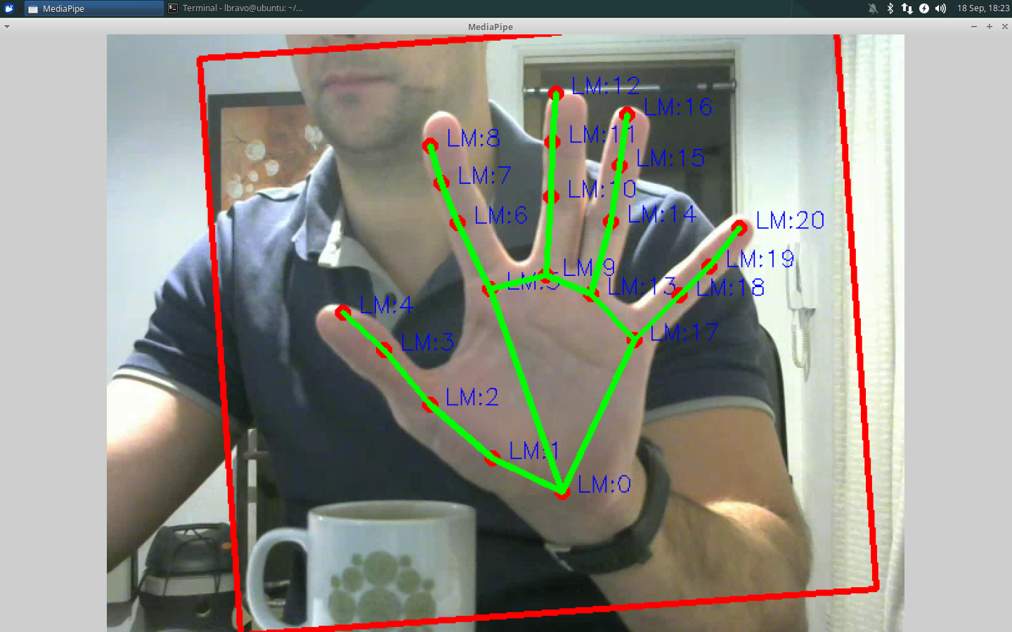
2.2 Solution
Using distance between index and middle finger to make a choice

